Slide 1
Twitter : #AdobeSummit

Slide 2

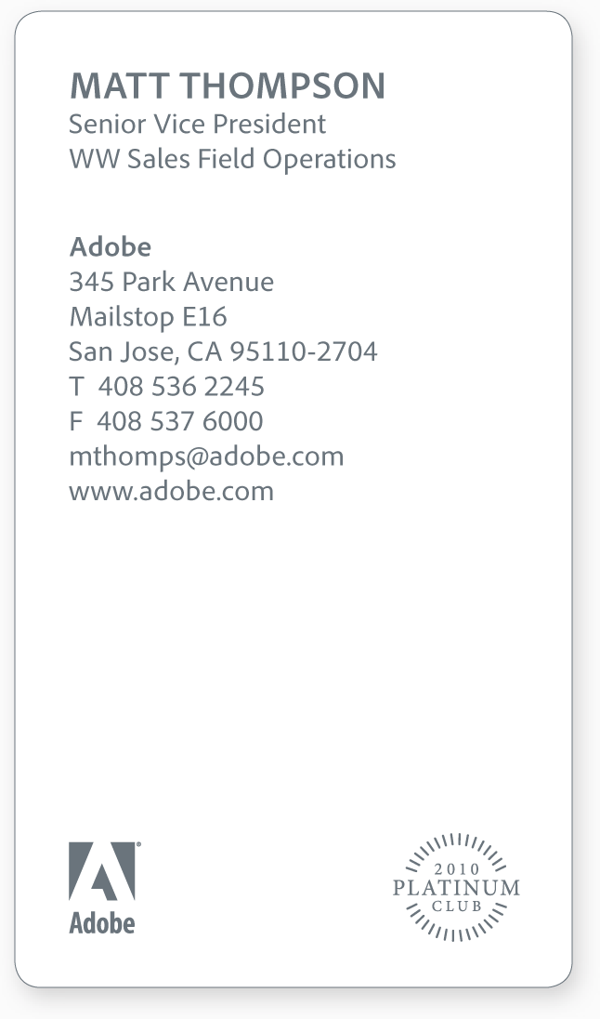
Adobe Experience Manager – Commerce Integration Framework – Omni Channel Commerce
Varun Venkataraman | Senior Consultant
Varun Venkataraman
SENIOR CONSULTANT
Adobe
Suite 1001,
1 Queens Road,
Melbourne
Victoria
T 0422521722
vvenkata@adobe.com

Slide 3
Agenda
| AEM Commerce Integration framework - Overview
| AEM Screens – Overview
| AEM Apps - Overview
4 | AEM Sites, Commerce, Apps and Screens - Mashup

Slide 4
Key Takeaways
1
2
3
Understand AEM Commerce Framework and what is available by default.
Understand AEM Commerce API and Extention points.
Leverage the framework to add simple functionalities

Slide 5
Agenda
| AEM Commerce Integration framework - Overview
| Introduction to default components and features in AEM
| Introduction to AEM Commerce API - Interfaces and Classes
4 | Introduction to AEM ElasticPath Commerce Provider Architecture, API - Interfaces and Classes

Slide 6
Introduction to the
AEM Commerce Integration
framework

Slide 7


















Adobe Marketing Cloud
SOLUTIONS
MEDIA OPTIMIZER
CAMPAIGN
SOCIAL
EXPERIENCE MANAGER
TARGET
ANALYTICS
PRIMETIME
AUDIENCE MANAGER
CORE SERVICES
PROFILES & AUDIENCES
USER MANAGEMENT & ADMINISTRATION
ASSETS
ACTIVATION
MOBILE
EXCHANGE
COLLABORATION
PLATFORM
Data & Content
Notes:
Let’s start off with a quick look at the big picture. Everything we talk about at Summit is part of the big picture story of Adobe Marketing Cloud. Well, here is a quick look at Adobe Marketing Cloud, in all its glory.
I don’t want to spend a lot of time here, but we want to be clear that Adobe Marketing Cloud is not just a slogan, a campaign, or a gimmick. Analysts have universally agreed that when it comes to marketing clouds, or hubs, or suites, or whatever you care to call them, Adobe has the secret sauce that actually makes the sum greater than the value of the individual parts.
UNLIKE other marketing suites and bundles that are an incomplete collection of point products that are barely interoperable, much less integrated, Adobe Marketing Cloud is a comprehensive set of best-in-class, integrated solutions, all built on a common data platform with a common set of powerful core services that creates a lift and, dare we say it, synergy you can’t get with a jumbled toolbox.
Adobe Marketing Cloud consists of 8 comprehensive and integrated solutions. This is where the execution happens:
Adobe Analytics—Get real-time analytics across online and offline channels to continuously improve the performance of marketing activities.
Adobe Experience Manager—Organize, manage, and deliver creative assets and other content across digital marketing channels.
Adobe Campaign—Plan and execute orchestrated campaigns across all channels.
Adobe Target—Test and target digital experiences to maximize business results.
Adobe Media Optimizer—Manage, forecast, and optimize your media mix to deliver peak return on your spend.
Adobe Social—Manage social marketing with a comprehensive platform that enables social listening, publishing, and analytics.
Adobe Primetime--Engage viewers across devices and deliver targeted ads independent of platform or device.
Audience Manager – Identity Management. Audience Activation, Cross Device Measurement, Audience Marketplace , Audience Optimization
And above and beyond best in class individual solutions, once you own any part of Adobe Marketing Cloud, you get the secret integrated sauce.
Adobe Marketing Cloud Core Services—A set of core technologies that allow each of the solutions to tap into a common framework and architecture, including Profiles & Audiences, Assets, Activation, Mobile, Exchange, Collaboration, the Exchange partner network, and User Management and Administration, all built upon a common data platform.
Okay, now let’s see how what we’re talking about today fits into this framework . . .

Slide 8
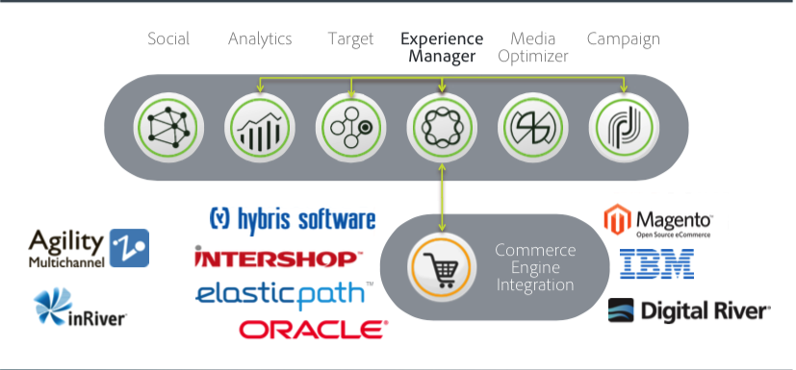
Commercial Commerce Engines Supported Today

Slide 9
AEM E-Commerce Architecture – 4 Layers
AEM E-Commerce Components
Product
Cart
Product
Checkout
Promotion
AEM E-Commerce API
AEM E-Commerce Implementation
JCR
HYBRIS
ELASTIC PATH
Other
JCR or E-Commerce Engine
JCR
HYBRIS
ELASTIC PATH
Other

Slide 10
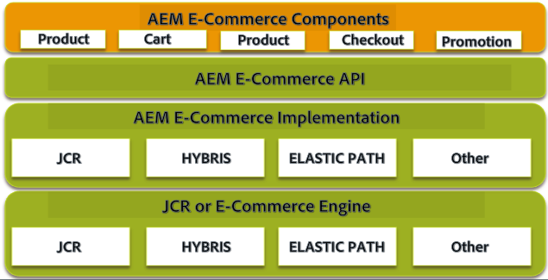
AEM E-Commerce Architecture – AEM E-Commerce Components – Layer 1
1. E-Commerce components
Front-end functionality and the shop as viewed by the user.
Rely on the eCommerce API to retrieve product data and perform actions related to the commerce engine.
Labs 2 and 3

Slide 11
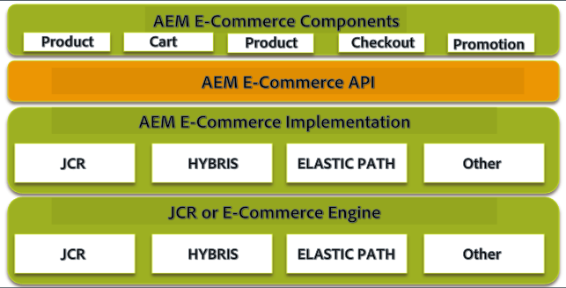
AEM E-Commerce Architecture – AEM E-Commerce Components – Layer 2
2. E-Commerce API
The central piece of AEM E-Commerce Architecture.
Frontend components can be built to implement an E-Commerce application.
The API is fixed by Adobe Experience Manager and cannot be adapted.
Labs 3

Slide 12
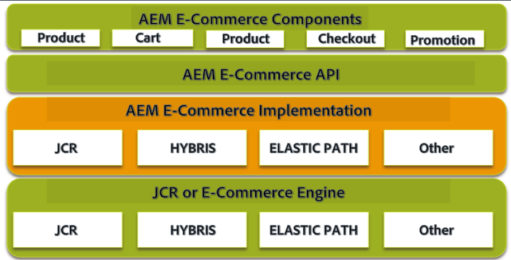
AEM E-Commerce Architecture – AEM E-Commerce Components – Layer 3
3. E-Commerce provider implementation
The eCommerce API can be implemented to integrate with a 3rd party eCommerce application (or) to create a custom (native) implementation.
Default : AEM implementation based on GRANITE (formerly CRX)
Reference Implementations by Adobe : Hybris, Elastic Path, Intershop
Reference Implementation through Partners : Oracle ATG, IBM Commerce.
Labs 3 and 4

Slide 13
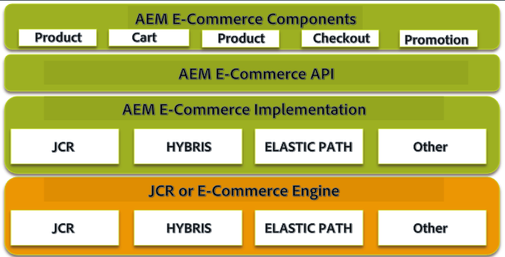
AEM E-Commerce Architecture – AEM E-Commerce Components – Layer 4
4. E-Commerce Engine
E-Commerce backend integrated in the provider implementation.
Example: JCR, Hybris, Elastic Path, Oracle ATG, IBM Commerce etc.
Labs 4

Slide 14
AEM Commerce – Key Terms

Slide 15
AEM Commerce – Key Terms – Part 1/3
1. Product
Basic item in the shop.
Example: Running shoe Nairobi, Coat Edmonton Winter, Honda Accord etc.
2. Variant Axis
Attribute fine-grained property of a product can be implemented as a variant axis.
Common variant axes : Color and Size
Example: Blue Nairobi running shoes, Nairobi running shoes size 10, Automatic Honda Accord, Red Honda Accord etc.
3. Variant
A Type of product and has one or more variant axis specified. Generally a Stock keeping Unit (SKU)
Example: Blue Nairobi Shoe of Size 10, Red Automatic Honda Accord etc.

Slide 16
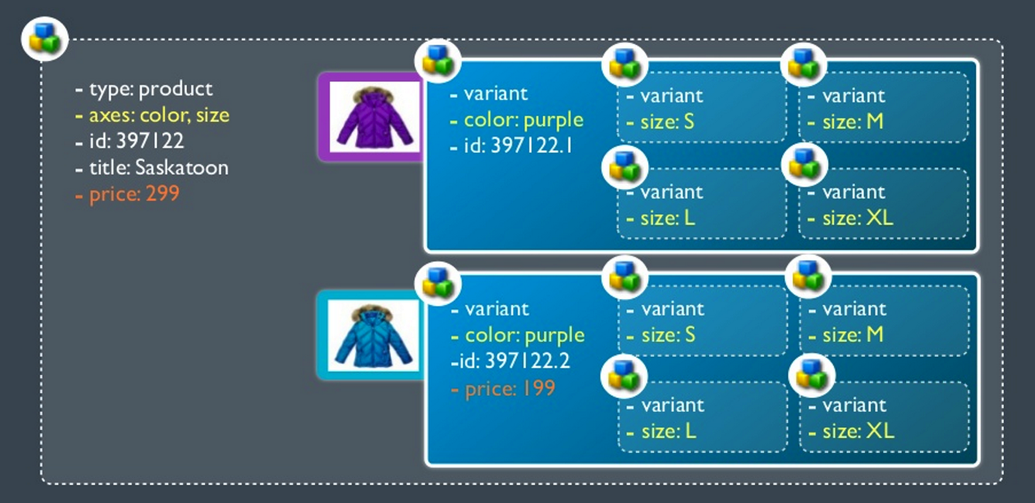
AEM Commerce – Key Terms – Products, Variants and Variant Axis – AS A SNAPSHOT

Slide 17
AEM Commerce – Key Terms – Part 2/3
4. Shopping Cart
When a commerce user intends to buy an item, he adds the product (variant) to the shopping cart.
For each product, the quantity of items added to the cart is specified.
5. Checkout
When a commerce user is done shopping, he proceeds to the Checkout.
In the following steps, he can actually order the items in his shopping cart.
6. Promotion
Promotions are discounts a commerce user receives when specific requirements are met.
Example: it is also possible to create Perfect Partner promotions, where a discount is given if a user buy two specific products.
7. Voucher
Vouchers are codes distributed to selected users which can be entered in the checkout process to receive a discount.

Slide 18
AEM Commerce – Key Terms – Part 3/3
8. Product Information Management Data (PIM)
Product information is provided by a commerce engine.
Contains all the product data required for the commerce application.
PIM data is stored in /etc/commerce/products (for default implementations – Geometrixx, Hybris, ElasticPath)
9. Catalog Blueprint
When a commerce user is done shopping, he proceeds to the Checkout.
In the following steps, he can actually order the items in his shopping cart.
10. Catalog
The generated catalog is usually located in /content and is created as a CQ live copy.

Slide 19
Exercise 1 – Summary and Key Takeaway
Import and Manage Products in Adobe Experience Manager !!
Use Cases : As a user, I would like to manage my companies products in my content management system, so I will be able to use this information to present to my customers.
Example :
Product management.
Product related pages.
Compare feature.

Slide 20
Agenda
| AEM Commerce Integration framework - Overview
| Introduction to default components and features in AEM
| Introduction to AEM Commerce API - Interfaces and Classes
4 | Introduction to AEM ElasticPath Commerce Provider Architecture, API - Interfaces and Classes

Slide 21
Introduction
to default components
and features
in AEM

Slide 22
AEM Commerce – Default Features
Things to Notes:
Default Templates should/can only be used in very specific locations of the JCR repository.
The default commerce components very likely need to be adapted for a customer environment.
Still, they can be used for guidance when implementing custom components and in some cases may be extended to reuse some functionality.
Stores | Comments
Catalogue Management and Rollout | Catalog management and rollout
Templates | /libs/commerce/templates
Components | /libs/commerce/components
ContextHub | /libs/commerce/contexthub/clientlibs

Slide 23
AEM Commerce – Catalogue Management
Adobe AEM provides a default structure how the elements of the commerce application are placed in the JCR repository.
This applies to the commerce implementations provided by Adobe (Granite, Hybris, Elastic Path). If a custom commerce implementation were created, the points below do not necessarily apply.
COMMERCE PIM
/etc/commerce/products
Catalog generation based on product tags.
COMMERCE CATALOG BLUEPRINT
/content/catalog
Live Copy
CATALOG
/content

Slide 24
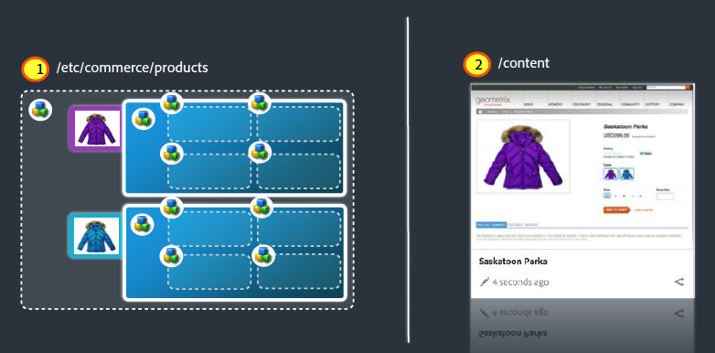
AEM Commerce – Commerce Management – AS A SNAPSHOT

Slide 25
AEM Commerce – Components – 1/2
Component | Comments
Call to Action | Setup of call to action components with images.
Image with Add to Cart Link | Annotate a image with Add to Cart buttons
Last-Viewed Call to Action | Tracking of the Call to action clicks
Navigation Product | A navigation list of products
Order History | History of the user’s orders
Payment Methods | Available payment methods for user
Product | Display of the product
Recently Viewed Products | A list of products viewed by user tracked through ContextHub
Recommended Products | Related products which are recommended.
Search | Search the product data
Shipping Methods | Available shipping methods for the product

Slide 26
AEM Commerce – Components – 2/2
Component | Purpose
Products Display | Product component used in the product data (/etc/commerce) and in the catalog content. Product nodes in the catalog content reference the PIM product node with the productData property.
Shopping Cart | Component that allows to add, delete, modify and display items in the current users shopping cart.
Voucher | Text box to use vouchers and mange them

Slide 27
AEM Commerce – Templates
Template name | Description | Allowed/suggested location
catalog | Catalog blueprint to create a new catalog from product data | /content/catalog
section | Catalog section based on product data | /content/catalog
voucher | Voucher which can be redeemed for a discount on a shopping cart. Default voucher implementation uses a promotion to specify the actual discount.
promotion | Promotion to give a discount based on the user segment or redeemed vouchers. | /content/campaigns

Slide 28
AEM Commerce – ClientContext and ContextHub Modules
Stores | Comments | Type
Recent Products | Records all products recently viewed. This can be used for personalization. | Store and Module
Related Products | Record related products for a given product. | Store and Module
Cart | Record what is in the cart in ContextHub | Store and Module
Abandoned Cart | Items added to cart which has been previously abandoned. | Store
Promotions | Promotions applicable based on campaign. | Module
Vouchers | Vouchers available to use for cart and user. | Module

Slide 29
Exercise 2 – Summary and Key Takeaway
The PIM managed from Exercise 1 is rolled out as pages using Page Rollout Hook in AEM Commerce Integration framework.
Use Cases : As a user, I would like to create consistent pages using blueprint template for product categories, sections and product pages, so I will be able to reduce effort in replicating page creation process for each page in authoring interface.
Example :
Product management.
Product related pages.
Compare feature.

Slide 30
Agenda
| AEM Commerce Integration framework - Overview
| Introduction to default components and features in AEM
| Introduction to AEM Commerce API - Interfaces and Classes
4 | Introduction to AEM ElasticPath Commerce Provider Architecture, API - Interfaces and Classes

Slide 31
AEM Commerce – Key Bundles
The following key bundles:
com.adobe.cq.commerce.cq-commerce-core
com.adobe.cq.commerce.cq-commerce-pim

Slide 32
AEM Commerce – Key Packages
The following key packages in the key bundles:
com.adobe.cq.commerce.api
com.adobe.cq.commerce.api.promotion
com.adobe.cq.commerce.common
com.adobe.cq.commerce.common.promotion
com.adobe.cq.commerce.pim.api

Slide 33
AEM Commerce – Key Interface and Classes – Commerce Management
Class | Purpose
CommerceServiceFactory. | OSGi entry point into the commerce provider.
CommerceService | Root of the Commerce API; other classes are fetched through it.
CommerceSession | Represents a user’s shopping session
CommerceSession.CartEntry | A CartEntry is a product with a given quantity in the user’s shopping cart.

Slide 34
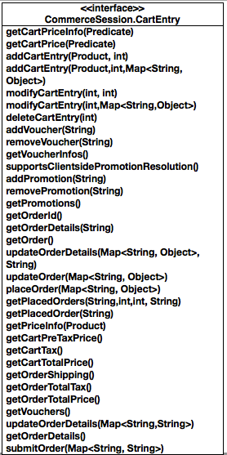
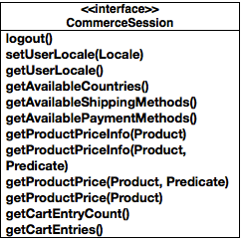
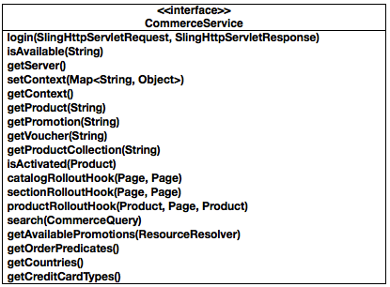
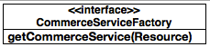
AEM Commerce – Key Interface and Classes – Commerce Management - UML

Slide 35
AEM Commerce – Key Classes and Interface – Product Management
Class | Purpose
PriceInfo | Provides information about prices for products and cart line items.
Product | Reflects resources that represent products and their variants. Class is adaptable from resources with sling:ResourceType commerce/components/product.

Slide 36
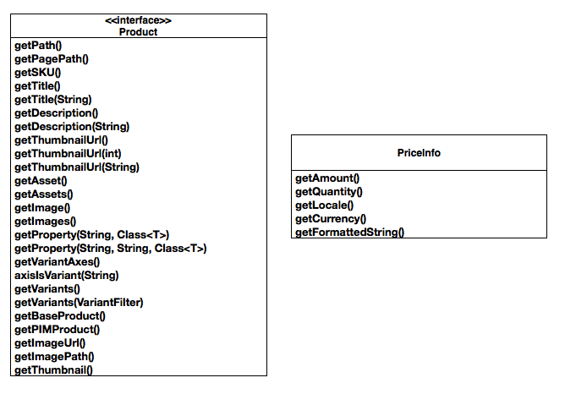
AEM Commerce – Key Interface and Classes - Product

Slide 37
AEM Commerce – Key Interfaces – Search
Class | Purpose
CommerceQuery | Holds properties about commerce searches such as the search text, the page size, the page to be retrieved of the result and the sortId to sort the results with.
CommerceResult | Describes a search result and contains info about the original search query, about applied sorts and about the current/total pages of the search

Slide 38
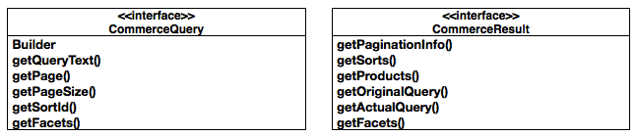
AEM Commerce – Key Interfaces – Search - UML

Slide 39
AEM Commerce – Key Interfaces – Vouchers and Promotions
Class | Purpose
Promotion | The Promotion interface represents a Promotion, which can be applied to certain segments and has a specific promotion type (e.g. free shipping, discount,…).
PromotionHandler | The PromotionHandler interface is implemented by services providing business logic for actual promotion. Services should define a property PromotionHandler.TYPE with a unique identifier used to reference the service from the configured promotions.
PromotionManager | An Interface that should be implemented by services, which provides access to promotions and vouchers.
Voucher | Interface that describes a voucher. The basic commerce framework requires that a voucher has at least a code and a concept of validity.
PromotionInfo

Slide 40
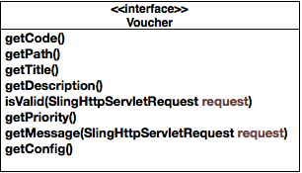
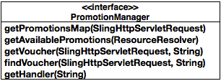
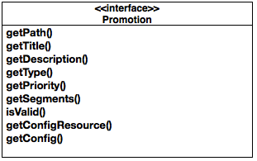
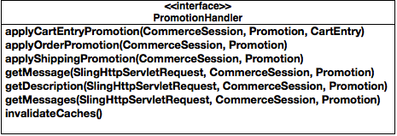
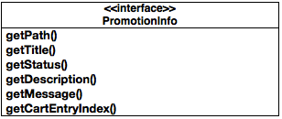
AEM Commerce – Key Interfaces – Vouchers and Promotions - Methods

Slide 41

Adobe Commerce API – Key Classes Interaction – Product Page
Front End Page/Components
AEM Commerce API
AEM Commerce JCR Impl
AEM PAGE
Product.jsp
CommerceService
CommerceSession
AbstractJcrCommerceService
AbstractJcrCommerceSession
Load Product
Page
Include
Adapt Request
Login()
Adapt to Product
based on product path
Load Product Data
to display from JCR
CommerceSession.getProductPrice ()

Slide 42
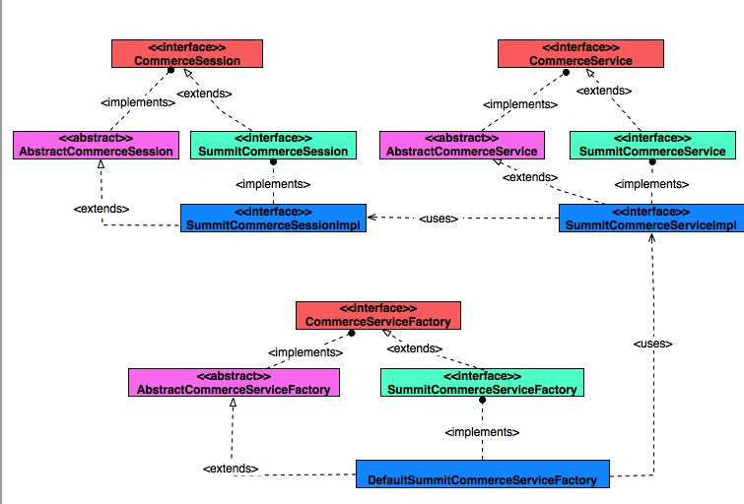
Ex 3 - Summary

Slide 43
Exercise 3 – Summary and Key Takeaway
Custom Commerce Implementation based on AEM Commerce Integration framework.
Use Cases : As a user, I would like to create my own commerce implementation, so that I can use my own commerce engine or extend and mange the products from JCR.
Example :
Custom Implementations
Custom Products

Slide 44
Agenda
| AEM Commerce Integration framework - Overview
| Introduction to default components and features in AEM
| Introduction to AEM Commerce API - Interfaces and Classes
4 | Introduction to AEM ElasticPath Commerce Provider Architecture, API - Interfaces and Classes

Slide 45
AEM Commerce – Reference Implementations
Implementation | Purpose | Availability
JCR | Reference implementation for JCR based commerce provider | Available through AEM Package manager
Elastic Path Commerce Implementation | Reference implementation for Elastic Path Commerce engine. | Available through AEM Package manager
Hybris Commerce Implementation | Reference Implementation for Hybris Commerce Engine | Available through AEM Package manager
Intershop Commerce Implementation | Reference implementation for Intershop Commerce Engine | Arriving soon !
ATG Commerce Implementation | Reference implementation for ATG Commerce Engine | Custom
Google Commerce Implementation | Reference implementation for Google Commerce | Arriving Soon !

Slide 46
AEM Commerce – Reference Implementations - Overview
Uses AEM Commerce Integration Framework.
Commerce components, Commerce API, and Commerce Implementation.
Commerce capabilities and business logic powered by Commerce Engine.

Slide 47


AEM Commerce – Brief Introduction to Hybris
Uses AEM Commerce Integration Framework.
Commerce components, Commerce API, and Commerce Implementation.
Commerce capabilities and business logic powered by Commerce Engine.
Synchronizes Users

Slide 48
AEM – Hybris Commerce – Architecture Overview
Commerce Component
Commerce Component
Commerce Component
AEM
Adobe Commerce API
Hybris Commerce Implementation
HTTP/REST
(OCC v1 APIs (Hybris released OCC v2 in hybris 5.4))
Hybris
Cart
Promotion
Users
Catalog
Order
Voucher
Price
Web Services
Backend
3rd Party
Payment Gateway
Inventory Mgmt

Slide 49
Adobe Commerce – Hybris Commerce Reference Implementation – Key Features
Feature | Purpose
User Integration and Synchronization | Synchronizes Users from hybris and AEM
Product import and Synchronization | Products from Hybris imported and synchronized on regular basis.
Checkout | Built on AEM and maintained from Hybris
Dynamic Price | Catered from Hybris
Cart | Dynamic Cart loaded from Hybris

Slide 50
Adobe Commerce – Hybris – Key Classes
Class | Purpose
DefaultHybrisService | An extension of the core CommerceService interface to add specific Hybris-related functions.
DefaultHybrisFactory | An extension of the core CommerceServiceFactory interface to add specific Hybris-related APIs.
DefaultHybrisSession | An extension of the core CommerceSession interface to add specific Hybris-related functions.
DefaultHybrisConfigurationService | Specification of server and connection.
DefaultHybrisConnection | Handle connections with Hybris and executes Command triggered through command patterns
DefaultHybrisImporter | This service helps importing product catalogs.
DefaultResponseParser | Parses the response received from REST call with Hybris and returns to calling services and components.

Slide 51

AEM Commerce – Elastic Path - Overview
Uses AEM Commerce Integration Framework.
Uses Commerce components, Commerce API, and Commerce Implementation.
EP uses Cortex which is a dynamic REST API layer which
exposes commerce capabilities
Cortex Java SDK marshals and un-marshalls request between Cortex REST API and the integration.
Commerce capabilities and business logic powered by Elastic Path Commerce Engine.
Additional Cortex resources can be created to integrate with other backend services, and exposed in Adobe Experience Manager through Cortex REST API.
Notes:
Why Cortex
(Level 3 - This is the Richardson Maturity Model, which reflects the different levels of REST as defined in Roy Fielding’s Dissertation on REST (http://www.ics.uci.edu/~fielding/pubs/dissertation/top.htm))
Stateless
Simplified deployments and scalability
Minimize session and client-side commerce state – simpler architecture
Single source of commerce truth – isolate all business rules
Stability
Link Relationships are stable, Endpoints may evolve
Support extensibility, composability and discoverability at the API level
Stability, Robustness, Longevity
Support extensibility and discoverability at the API level
API extension without breaking existing contracts and touchpoints
Development Model supports Low TCO
Modularity and reuse of resources through OSGi
Patterns, patterns, patterns when consuming and implementing the API

Slide 52

AEM – Elastic Path Commerce – Architecture Overview
Commerce Component
Commerce Component
Commerce Component
Adobe Commerce API
AEM
ElasticPath Commerce Implementation
JCR
Cortex Java SDK
HTTP/REST
Resource
Resource
Resource
Cortex
Integration
Integration
Integration
Web Services
Commerce
Engine
Cart
Promotion
Order
Payment Gateway
Inventory Mgmt
Backend
3rd Party
Notes:
Elastic Path Commerce for Adobe® Marketing Cloud ships with Core Commerce (services), the Commerce Integration Platform, and additional connectors, adaptors, and components that integrate core commerce services with functionality in Adobe Experience Manager (and by associated connection, other solutions in the Adobe Marketing Cloud).
Core Commerce (Commerce Engine) includes capabilities that allow you to:
Monetize through cart & checkout, and order fulfillment capabilities
Provide your product team tools to increase conversion through offer/catalog management, merchandising, pricing, promotions, and segmentation capabilities
Enhances the customer’s experience by providing search & browse, customer care and customer profile capabilities
Provide your operations team with an administration and monitoring tool
Commerce Integration Platform (Cortex SDK) includes capabilities that allow you to:
Easily integrate with downstream and backend systems through the Enterprise Integration Framework
Synchronize data between environments and systems using our Staging tools
Surface up core commerce and capabilities through one easy to understand hypermedia API and also provide the tooling to help you achieve this
Authenticate with OAuth
Elastic Path also offers Extended Commerce (solutions)
Managed cloud (by Rackspace®) – an add-on providing managed hosting, and hosting options to power your website. Other providers may be available.
Subscriptions (by Aria™) – an add-on providing complex subscriptions and recurring billing capabilities for enterprises with mature requirements in this area. Other providers may be available.
PIM by Agility® – an add-on providing PIM capabilities for your enterprise. The solution provides onboarding, enrichment approval and syndication of product marketing information for all channels, and touch points
OMS by Jagged Peak® – an add-on providing OMS capabilities for your enterprise. The solution provides software and services that enhance the scalability, flexibility, and profitability of omnichannel businesses

Slide 53
AEM Commerce – Elastic Path - Cortex API
Level 3 REST API (HATEOAS) - API responses include links and information needed by client applications to perform key scenarios and transactions.
Concept | Definition
Resources | A service URL that provides data or performs an action
Links | Self-describing links to related data and actions in different resources
Forms | Describe information to be collected from the client
Zoom | Consolidates related link requests into one request.
Selectors | Allow for interaction by describing choices
NeedInfo | Indicates data required for workflow when it is missing
Notes:
Hypermedia As The Engine Of Application State (HATEOAS)
Developers know three things:
Root URL
Content-types of the resources
Relationships between resources
Developers do not need to know the URLs
Cortex adds the following hypermedia controls to level 3 REST:
Forms
Zoom
Selectors
NeedInfo

Slide 54
AEM Commerce – Elastic Path - Cortex API – Selected Resources
Discoverable hypermedia API - Concepts and data are “accessible,” easily related to common personal experiences of shopping online
Resource | Description
/profiles | Shopper’s profile
/authentication | Login/Logout
/items | Saleable goods
/itemdefinitions | Deep definition of items
/itemselections | Item Configurations
/prices | Prices of items
/availabilities | Inventory of items
/media | Rich media of items
/searches | Product Searches
/navigation | Product Navigation
/slots | Personalized Content
/recommendations | Recommended items
Resource | Description
/carts | Shopper’s basket of items
/coupons | Promotional coupon codes
/discounts | Promotional discount amounts
/promotions | Shopper incentives
/orders | Shopper’s orders
/shipments | Shipments for a given purchase
/deliverymethods | Shipping options
/paymentmethods | Payment Methods
/taxes | Tax calculations
/totals | Cart calculations
/purchases | Shopper’s purchases
/geographies | Valid countries and regions
Notes:
This list is not exhaustive, and does not include sub-resources.
SE Note: This would be a good point to demonstrate Cortex Studio
Illustrates the visibility of patterns and state changes

Slide 55
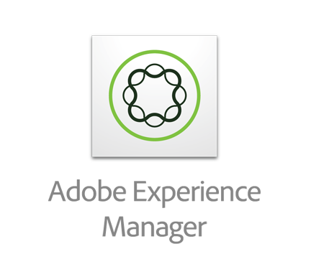
AEM – Elastic Path Commerce – Key Classes
Class | Purpose
CortexContext | Encapsulates Cortex's authentication context. To use Cortex resources, you must have a context. Cortex allows both anonymous and registered shoppers !
AemCortexContextManager | Manages the persistence and retrieval of contexts (using Cookies in AEM).
CortexClientFactory | Provides access to Cortex Java SDK and the CortexClient facade for user-scoped Cortex calls. Most interaction with Cortex will be through a CortexClient instance.
JAX-RS Client | Provides direct connections to other HTTP services and/or Cortex for cases that do not require a user-scoped connection.
CortexSdkServiceFactory | Provides access to services that manage Cortex

Slide 56
AEM – Elastic Path Commerce – Key Classes
Class | Purpose
ElasticPathCommerceService | An extension of the core CommerceService interface to add specific ElasticPath-related functions.
ElasticPathCommerceServiceFactory | An extension of the core CommerceServiceFactory interface to add specific ElasticPath-related APIs.
ElasticPathCommerceSession | An extension of the core CommerceSession interface to add specific ElasticPath-related functions.
https://cms-developers.elasticpath.com/6%20v1.2.0.PREV/Configuration/EP_AEM_OSGi_Configuration

Slide 57
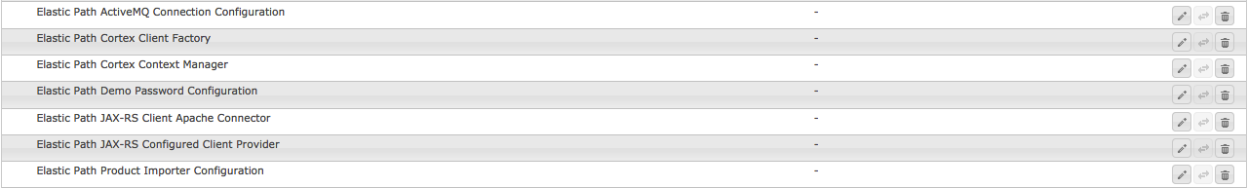
AEM Commerce – Elastic Path Key Configurations

Slide 58
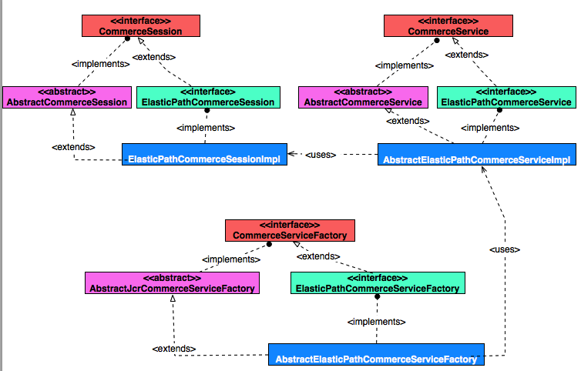
AEM Commerce – Elastic Path – Class Interaction

Slide 59
Exercise 4 – Summary and Key Takeaway
Abstract implementations for Hybris or Elastic Path in AEM Commerce Framework is a scalable framework for extension based on client use cases.
Use Cases : As a user, I would like to extend my commerce framework for my commerce servers provided by AEM such as Hybris or Elastic Path to create customizations, so I can address my customer requirements.
Example :
1. Create additional attributes in my commerce service for products and make sure this appears in AEM.
2. Customize cart data received from my commerce service to appear in AEM.

Slide 60
Key Takeaways - Revisited
1
2
3
Understand AEM Commerce Framework and what is available by default.
Understand AEM Commerce API and Extention points.
Leverage the framework to add simple functionalities

Slide 61
References
https://docs.adobe.com/docs/en/cq/current/ecommerce/eCommerce-framework.html
http://docs.adobe.com/docs/en/cq/current/developing/java_api_reference.html
https://docs.adobe.com/docs/en/cq/current/ecommerce/eCommerce-hybris.html
https://docs.adobe.com/docs/en/cq/current/ecommerce/eCommerce-intershop.html
https://docs.adobe.com/docs/en/cq/current/ecommerce/eCommerce-native.html
http://docs.adobe.com/docs/en/cq/current/javadoc/index.html
http://www.elasticpath.com/adobe-ecommerce
https://developers.elasticpath.com/
https://github.com/Adobe-Marketing-Cloud/aem-commerce-framework-extensions

Slide 62
Q&A
Varun Venkataraman
vvenkata@adobe.com
Twitter: @varunstech
Summit Twitter Tag : #AdobeSummit
LinkedIn: http://au.linkedin.com/in/varunv1

Slide 63

Varun Venkataraman
SENIOR TECHNICAL CONSULTANT
Adobe
Suite 1001,
1 Queens Road,
Melbourne
Victoria
T 0422521722
vvenkata@adobe.com

